Slide 1
Syracuse Behavioral Healthcare
Opioid Treatment Program (OTP)

Slide 2
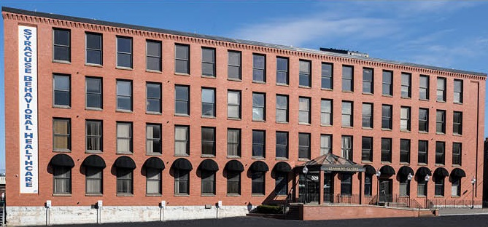
Welcome to SBH
In the past year, Syracuse Behavioral Healthcare helped 5,544 individuals struggling with drug or alcohol substance use disorders. A complete continuum of care from Detox to Inpatient, from Outpatient Rehabilitation to Residential Rehab services, and from Ancillary Withdrawal to Medication Assisted Treatments. On 4/10/17, SBH opened its Opioid Treatment Program.

Slide 3
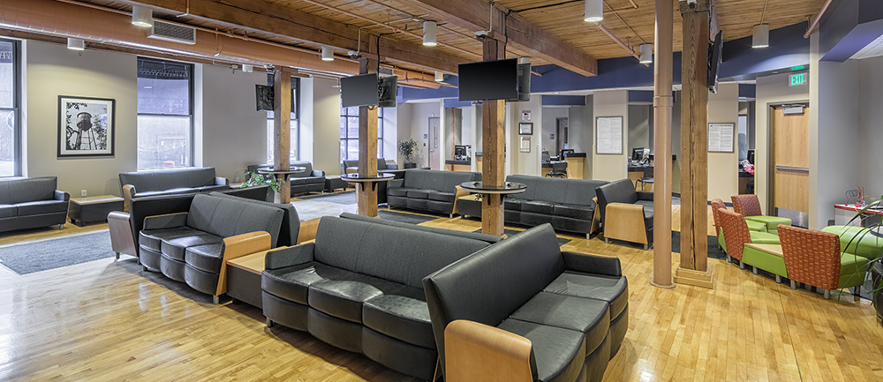
Outpatient/OTP Services Waiting Room
SBH Outpatient Services provides a wide variety of enhanced outpatient treatment and education services for substance use disorders, mental health diagnosis, and problem gambling. Open access hours allow for patients to be seen without an appointment. OTP patients are initially screened by phone and offered an assessment if appropriate.

Slide 4
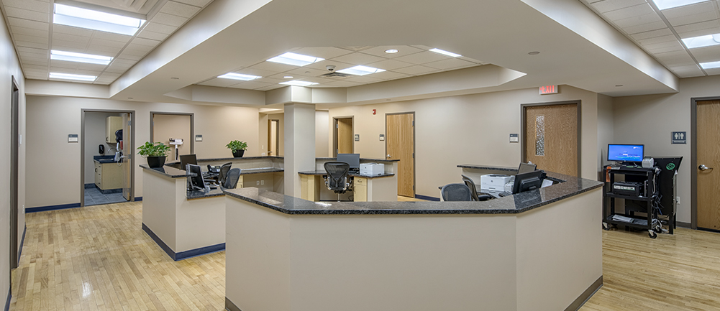
Outpatient/OTP Medical Suite
As part of our continuum of care, SBH offers primary care screening to measure and monitor specific health indicators associated with increased risk of medical illness and early death. These include a Body Mass Index (BMI), Blood Pressure Screenings and Tobacco Use Screenings. Additionally, bloodwork, TB testing, and EKGs are offered on-site to better assess patient care.

Slide 5
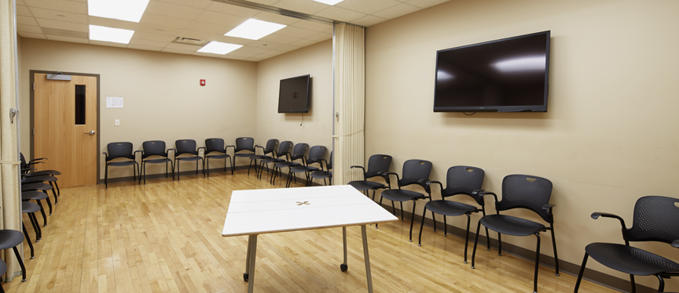
OTP Expanded Group Room
As a Certified Community Behavioral Health Clinic, SBH provides a comprehensive array of services necessary to create access, stabilize people in crisis, and provide the appropriate treatment for those with substance use and mental health disorders.

Slide 6
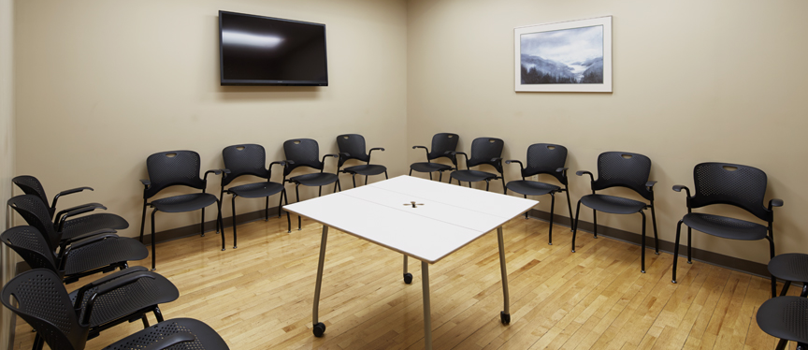
OTP Standard Group Room
Both our clinical and medical services focus on integration that emphasizes recovery, wellness, trauma-informed and person-centered care as well as other physical-behavioral health needs.

Slide 7
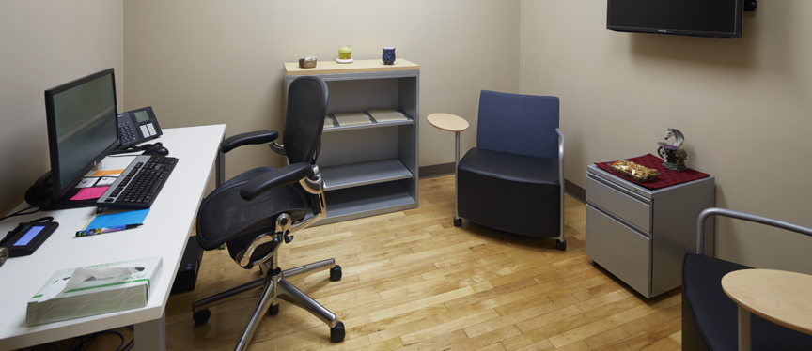
OTP Clinical Office
SBH professionals facilitate medical, psychiatric and clinical assessment of treatment needs while utilizing medication assisted treatment, individual counseling, group counseling, and family sessions to support treatment recovery goals. SBH professions are trained in collaborative documentation so patients are involved directly in the development of their treatment.

Slide 8
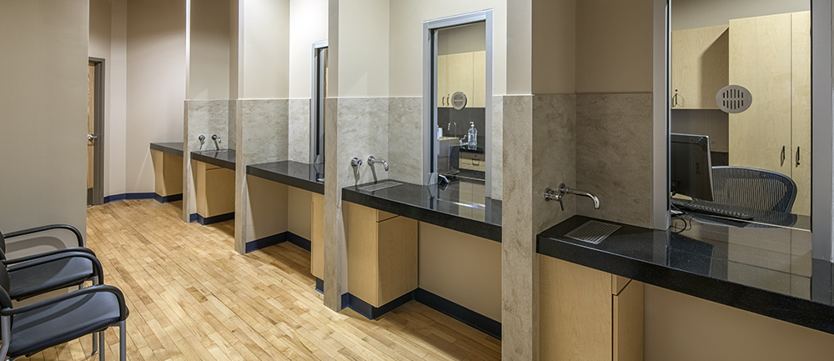
OTP Medication Dispensing Area
Medication Assisted Therapies - Methadone, Suboxone, and Vivitrol - are dispensed on-site with approved take home privileges over time. Treatment and medical sessions are provided by a multi-disciplinary team that focuses on individual patient needs.

Slide 9
Thank you!
Syracuse Behavioral Healthcare
Opioid Treatment Program
329 North Salina Street, Suite 101
Syracuse, NY 13203
Phone: 315-471-1564
Fax: 315-471-2531
Contact: Kevin Howard – OTP Clinic Director

